Slide 1
QUAID-E-AWAM UNIVERSITY OF ENGINEERING, SCIENCE & TECHNOLOGY Nawabshah
DEPARTMENT OF INFORMATION TECHNOLOGY
Enhancing Image Steganography Techniques for Secure Communication
By:
Names | Roll Number | Designations
Ubaidullah Qureshi | 20IT-16 | Leader
Waqas | 20IT-07 | Member
Sawera | 20IT-64 | Member
Supervisor: Dr. Saima Siraj Soomro

Slide 2
Contents
Introduction
Literature Review
Problem Statement
Aim & Objectives of Research
Proposed Methodology
Possible Outcomes
Utilization of Results
Work Plan
List of References

Slide 3
Introduction
Steganography is like a secret way of writing messages. It's a way to hide messages so that only the person sending it and the person meant to get it know it's there. Others wouldn't even know there's a message hidden [1].
Steganography is like the skill of "hidden writing. It involves methods to conceal information within things called "Cover Objects [2].

Slide 4
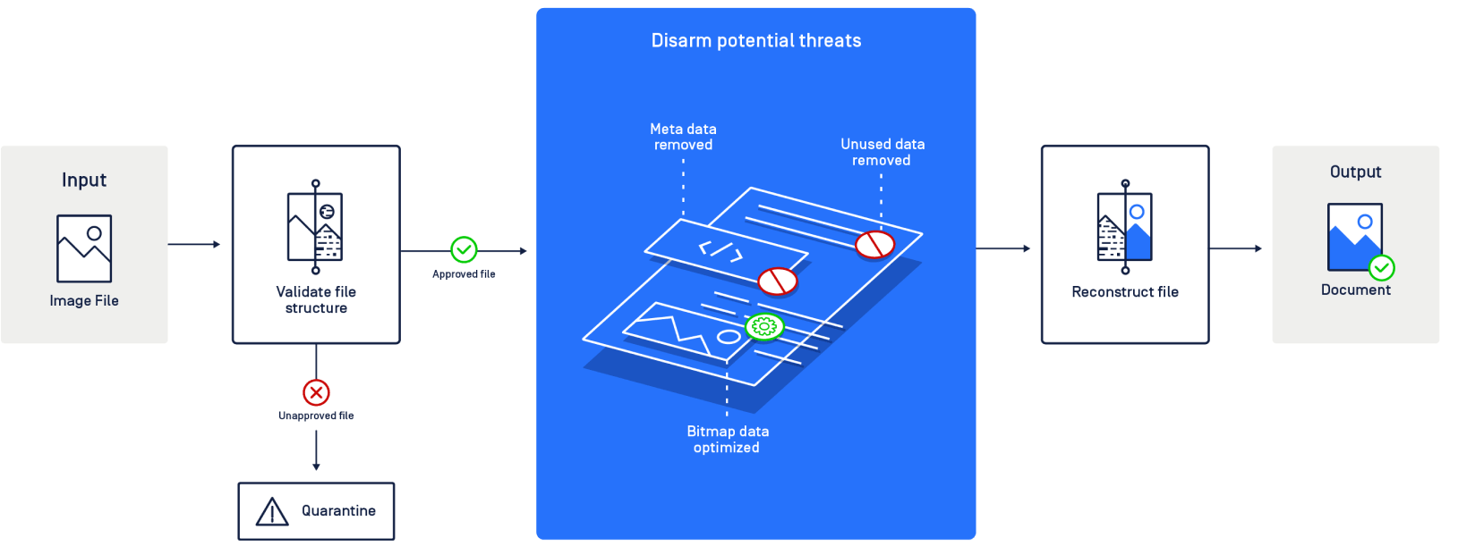
Introduction (cont..)

Slide 5
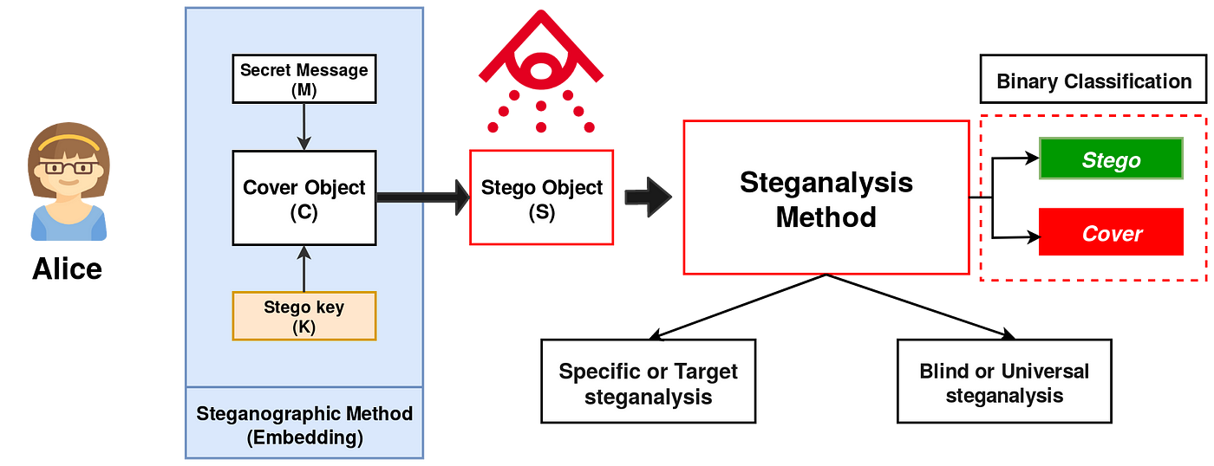
Introduction (cont..)

Slide 6
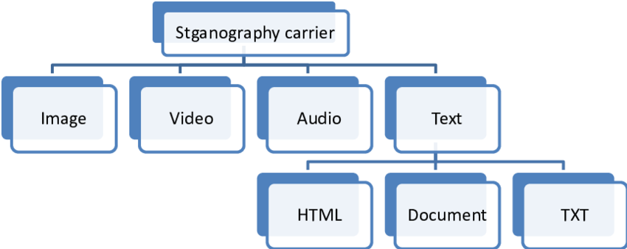
Types of Steganography:

Slide 7
Types of Steganography:
Steganography Types | Description
Text Steganography | Hides information by encoding it into letters of text files [3].
Image Steganography | Conceals data using images, manipulating pixel intensities. Terms: Cover-Image, Message, Stego-Image, Stego-Key [4].
Audio Steganography | Hides data within sound, often using watermarking. Commonly used for digital media playback [5].
Video Steganography | Embeds data in video files using techniques like DCT. Common formats: H.264, MP4, MPEG, AVI [6].
Network/Protocol Steganography | Conceals data within network protocols (TCP, UDP, ICMP, IP) as a cover object, used in covert channels [7].

Slide 8
Literature Review: Advances in Image Steganography Techniques
Westfeld, A. Provos, N., & Honeyman, P. [8][9]
-Traditional Methods:
Early image steganography focused on LSB substitution (Johnson & Smith, 1998). Least Significant Bit (LSB) substitution.
These techniques were effective but vulnerable to visual attacks and had limited capacity (Westfeld, 2001).Vulnerabilities and limitations
Provos and Honeyman (2003) emphasized vulnerabilities in LSB-based methods, driving the development of more robust approaches. Evolution towards more robust approaches.

Slide 9
Fridrich, J., Goljan A, et al [10]
-Frequency Domain Techniques
Frequency domain techniques gained prominence for information embedding (Fridrich et al., 2009). Importance of frequency domain for robust steganography.
Fridrich et al. introduced a method using frequency domain transformations. Method based on frequency domain transformations
The approach demonstrated increased capacity and resistance to common steganalysis techniques.

Slide 10
Yang, B., Yao, H., & Tong, W., et al [11]
-Transform Domain Methods:
Transform domain methods like DCT and DWT enhance steganographic robustness. Adoption of discrete cosine transform (DCT) and discrete wavelet transform (DWT).
Yang et al. (2015) proposed a DCT-based steganography algorithm. DCT-based algorithm for improved security and reduced visual distortion
The algorithm achieved higher security levels while minimizing visual distortion.

Slide 11
Zhang, Y., Qiu, M., & Zhang, Y. et al [12]
Deep Learning Approaches:
Recent years saw a rise in deep learning applied to image steganography. Integration of deep learning in image steganography.
Zhang et al. (2020) introduced a CNN-based method. CNN-based method for complex pattern learning
The method can learn complex patterns for information embedding and exhibits superior resistance to steganalysis.

Slide 12
Li, B., & Wang, Y. , et al [13]
Challenges and Future Directions
Challenges persist in image steganography despite progress (Li and Wang, 2018). Ongoing challenges in steganography
Li and Wang emphasized the necessity for methods resistant to advanced steganalysis techniques.
Balancing high capacity with imperceptibility remains a key challenge (Ker, 2016). Balancing high capacity and imperceptibility

Slide 13
Ker, A. D. , et al [14]
Applications
Image steganography extends beyond security and privacy concerns. Versatility of image steganography in various domains
Kapoor et al. (2017) researched medical image steganography. Medical image steganography for secure data transmission
The study focused on secure transmission of sensitive medical data, highlighting the versatility of steganographic techniques.

Slide 14
Kapoor, D., Sood, A., & Mahajan, A. , et al [15]
Conclusion
Image steganography has evolved from LSB to advanced techniques in frequency and transform domains. Evolution from traditional to advanced steganography.
Strides in deep learning applications show promise in the field. Promising strides in deep learning applications.
Addressing challenges and exploring diverse applications will likely shape the future trajectory of image steganography research. Future directions and challenges.

Slide 15
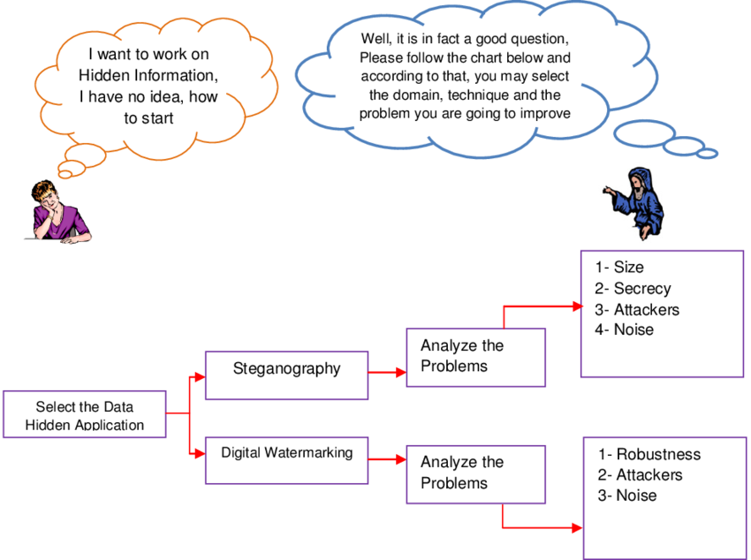
Problem Statement:

Slide 16
Problem Statement: Advancing Image Steganography for Secure Communication
1. Vulnerabilities in Traditional Methods:
Susceptibility to visual attacks and limited capacity (Johnson & Smith, 1998; Westfeld, 2001).
2. Complexity in Frequency Domain Techniques:
Need to address complexity and enhance robustness against evolving steganalysis techniques (Fridrich et al., 2009).
3. Balancing Act in Transform Domain Methods:
Challenges in achieving a balance between high capacity and imperceptibility (Yang et al., 2015).

Slide 17
4. Deep Learning Integration:
Promising patterns learned through deep learning, yet requiring further exploration for enhanced effectiveness and reduced vulnerabilities (Zhang et al., 2020).
5. Practical Applications:
Ensuring resilience in real-world scenarios, addressing concerns related to data integrity, privacy, and secure communication, particularly in applications like medical data transmission (Kapoor et al., 2017).
6. Addressing Practical Applications:
Ensuring resilience in real-world scenarios, addressing concerns related to data integrity, privacy, and secure communication, particularly in applications like medical data transmission (Kapoor et al., 2017).

Slide 18
Aim & Objectives:
Aim:
This research aims to elevate image steganography, boosting its resilience and data capacity for secure communication and practical utility.
Objectives:
Assess Weaknesses in Conventional Approaches:
Optimize Frequency Domain Techniques:
Achieve Balance in Transform Domain Methods:
Refine Deep Learning Integration:
Tackle Practical Applications:
Validate and Benchmark Developed Techniques:
Provide Practical Implementation Guidelines:
Contribute to Academic Advancement:

Slide 19
Proposed Methodology
2. Analysis of Traditional Methods:
3. Optimization of Frequency Domain Techniques:
4. Development of Transform Domain Methods:
5. Integration of Deep Learning:
1. Literature Review

Slide 20
Proposed Methodology
7. Validation and Benchmarking:
8. Guidelines for Implementation:
9. Dissemination of Results:
10. Iterative Refinement:
6. Practical Application Testing:

Slide 21
Proposed Methodology
Literature Review:
Conduct an extensive review of current literature to gain insights into existing methodologies, challenges, and advancements in image steganography.
2. Analysis of Traditional Methods:
Assess vulnerabilities in traditional image steganography methods, focusing on LSB substitution. Analyze their limitations and identify areas for improvement (Johnson & Smith, 1998; Westfeld, 2001).
3. Optimization of Frequency Domain Techniques:
Investigate and optimize frequency domain techniques, emphasizing enhanced security and increased capacity. Develop methods to address complexities and bolster resistance against evolving steganalysis techniques (Fridrich et al., 2009).

Slide 22
4. Development of Transform Domain Methods:
Design and implement techniques within the transform domain, such as DCT and DWT, to achieve a harmonious balance between high data capacity and imperceptibility (Yang et al., 2015).
5. Integration of Deep Learning:
Explore and refine the integration of deep learning, particularly CNNs, to improve the learning of intricate patterns and minimize vulnerabilities in image steganography (Zhang et al., 2020).
4. Development of Transform Domain Methods:
Design and implement techniques within the transform domain, such as DCT and DWT, to achieve a harmonious balance between high data capacity and imperceptibility (Yang et al., 2015).
5. Integration of Deep Learning:
Explore and refine the integration of deep learning, particularly CNNs, to improve the learning of intricate patterns and minimize vulnerabilities in image steganography (Zhang et al., 2020).

Slide 23
8. Guidelines for Implementation:
Summarize research findings and create user-friendly guidelines for implementing enhanced image steganography techniques across diverse applications. Ensure the guidelines adhere to security standards and are accessible for practical use.
9. Dissemination of Results:
Publish research findings in peer-reviewed journals, present at conferences, and engage with the academic community to share insights and contribute to the ongoing discourse on image steganography.
10 . Iterative Refinement:
Iterate and refine methodologies based on feedback, emerging technologies, and new insights gained during the implementation and testing phases.

Slide 24
Possible Outcomes: Advancements in Image Steganography
Enhanced Robustness:
Improved security features and decreased vulnerability, particularly in traditional methods, leading to more robust image steganography techniques.
2. Increased Data Capacity:
Optimization of frequency domain techniques and transformative approaches, resulting in enhanced data capacity without compromising imperceptibility.
3. Balanced Transform Domain Methods:

Slide 25
Work Plan
Task | Time Required
Literature review | Already done
 | 1 month
 | 1 month
Thesis write-up | 1 month

Slide 26
List of References
[1] Moerland, T., “Steganography and Steganalysis”, Leiden Institute of Advanced Computing Science.
[2] Silman, J., “Steganography and Steganalysis: An Overview”, SANS Institute, 2001.
[3] Moerland, T., “Steganography and Steganalysis”, Leiden Institute of Advanced Computing Science,
[4] Johnson, N.F. & Jajodia, S., “Exploring Steganography: Seeing the Unseen”, Computer Journal,
February 1998
[5] Artz, D., “Digital Steganography: Hiding Data within Data”, IEEE Internet Computing Journal, June
2001
[6] Kapotas SK Skodras AN, (2008) A new data hiding scheme for scene change detection in H. 264 encodedvideo sequences, In: 2008 IEEE. International Conference on Multimedia and Expo
[7] Ahsan, K. & Kundur, D., “Practical Data hiding in TCP/IP”, Proceedings of the Workshop on
Multimedia Security at ACM Multimedia, 2002.

Slide 27
List of References
[8] Westfeld, A. (2001). Proceedings of the Information Hiding Workshop, 289-302.
[9] Provos, N., & Honeyman, P. (2003). IEEE Security & Privacy, 1(3), 32-44.
[10] Fridrich, J., Goljan, M., & Du, R. (2009). Proceedings of the ACM Workshop on Multimedia and Security, 27-36.
[11] Yang, B., Yao, H., & Tong, W. (2015). International Journal of Multimedia and Ubiquitous Engineering, 10(2), 377-386.
[12] Zhang, Y., Qiu, M., & Zhang, Y. (2020). IEEE Access, 8, 28439-28455.
[13] Li, B., & Wang, Y. (2018). IEEE Transactions on Information Forensics and Security, 13(7), 1738-1752.
[14] Ker, A. D. (2016). International Journal of Computer Applications, 136(8), 10-14.
[15]Kapoor, D., Sood, A., & Mahajan, A. (2017). Procedia Computer Science, 122, 667-674.

